Slide 1
Mask R-CNN

Slide 2
Faster R-CNN and YOLO are good at detecting the objects in the input image.
They also have very low detection time and can be used in real-time systems.
However, there is a challenge that can’t be dealt with object detection, the bounding box generated by YOLO and Faster R-CNN does not give any indication about the shape of the object.

Slide 4
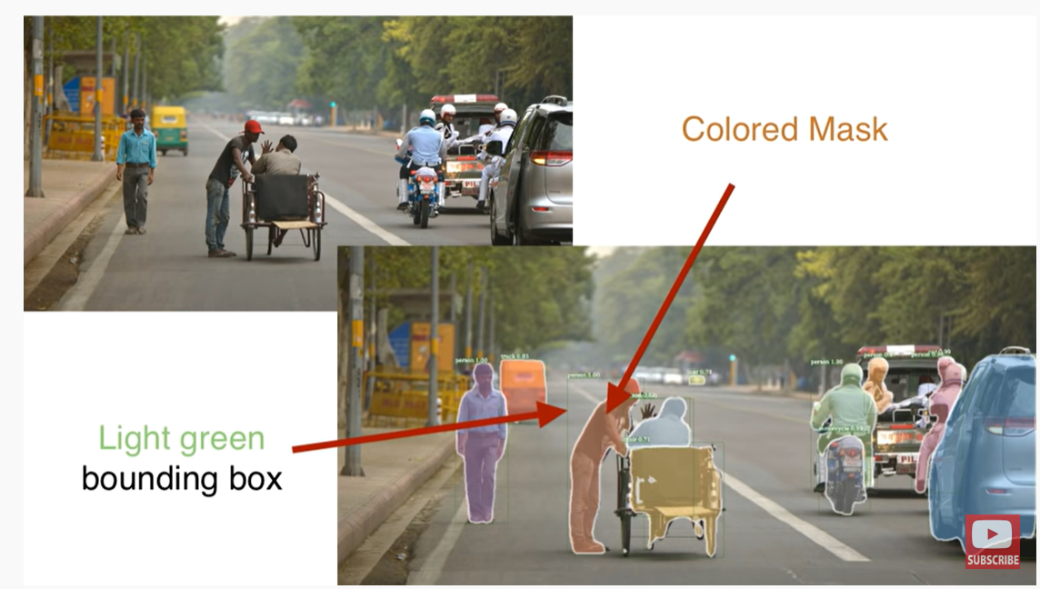

Slide 6
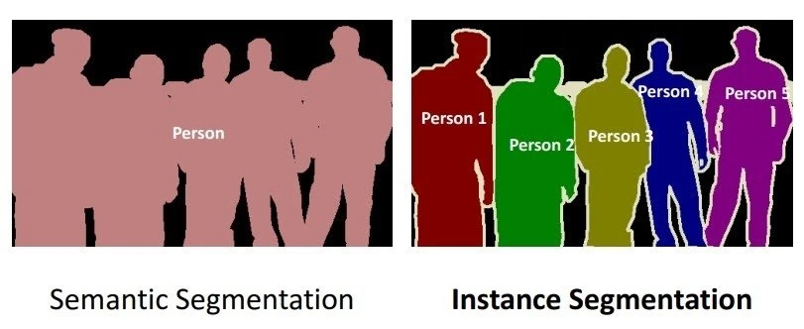
Semantic Segmentation
Semantic segmentation classifies each pixel into a fixed set of categories without differentiating object instances. In other words, semantic segmentation deals with the identification/classification of similar objects as a single class from the pixel level. As shown in the image above, all objects were classified as a single entity (person). Semantic segmentation is otherwise known as background segmentation because it separates the subjects of the image from the background.

Slide 7
Instance Segmentation
Instance Segmentation, or Instance Recognition, deals with the correct detection of all objects in an image while also precisely segmenting each instance. It is, therefore, the combination of object detection, object localization, and object classification. In other words, this type of segmentation goes further to give a clear distinction between each object classified as similar instances. As shown in the example image above, for Instance Segmentation, all objects are persons, but this segmentation process separates each person as a single entity. Semantic segmentation is otherwise known as foreground segmentation because it accentuates the subjects of the image instead of the background.

Slide 8
How does Mask R-CNN work?
Mask R-CNN was built using Faster R-CNN. While Faster R-CNN has 2 outputs for each candidate object, a class label and a bounding-box offset, Mask R-CNN is the addition of a third branch that outputs the object mask. The additional mask output is distinct from the class and box outputs, requiring the extraction of a much finer spatial layout of an object. Mask R-CNN is an extension of Faster R-CNN and works by adding a branch for predicting an object mask (Region of Interest) in parallel with the existing branch for bounding box recognition.

Slide 9
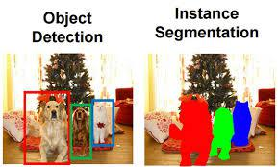
Instance Segmentation:
This segmentation identifies each instance (occurrence of each object present in the image and colour them with different pixel).
It basically works to classify each pixel location and generate the segmentation mask for each of the objects in the image.
This approach gives more idea about the objects in the image because it preserves the safety of those objects while recognizing it.

Slide 10
The key element of Mask R-CNN is the pixel-to-pixel alignment, which is the main missing piece of Fast/Faster R-CNN. Mask R-CNN adopts the same two-stage procedure with an identical first stage (which is RPN). In the second stage, in parallel to predicting the class and box offset, Mask R-CNN also outputs a binary mask for each RoI. This is in contrast to most recent systems, where classification depends on mask predictions. Furthermore, Mask R-CNN is simple to implement and train given the Faster R-CNN framework, which facilitates a wide range of flexible architecture designs. Additionally, the mask branch only adds a small computational overhead, enabling a fast system and rapid experimentation.

Slide 11
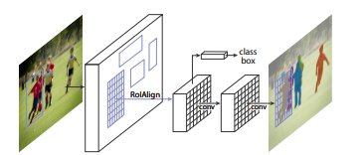
Mask R-CNN architecture:
Mask R-CNN was proposed by Kaiming He et al. in 2017.
It is very similar to Faster R-CNN except there is another layer to predict segmented.
The stage of region proposal generation is same in both the architecture the second stage which works in parallel predict class, generate bounding box as well as outputs a binary mask for each RoI.

Slide 12
It comprises of –
Backbone Network
Region Proposal Network
Mask Representation
RoI Align

Slide 13
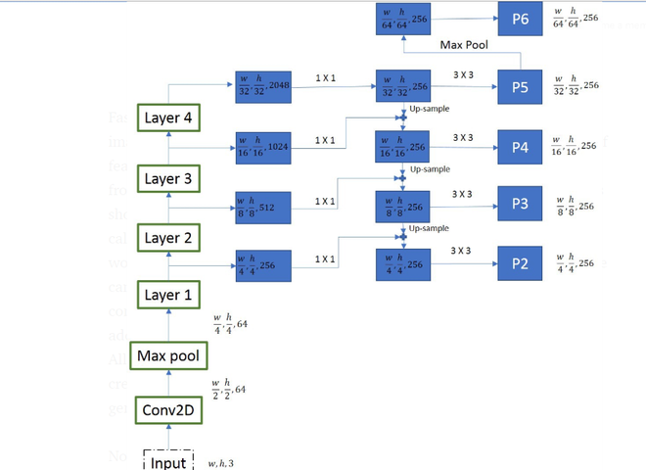
Backbone Network:
The authors of Mask R-CNN experimented on two kinds of backbone network.
The first is standard ResNet architecture (ResNet-C4) and another is ResNet with feature pyramid network.
The standard ResNet architecture was similar to that of Faster R-CNN but the ResNet-FPN has proposed some modification.
This consists of a multi-layer RoI generation. This multi layer feature pyramid network generate RoI of different scale which improves the accuracy of previous ResNet architecture.

Slide 14
At every layer the feature maps size is reduced by half and number of feature maps are doubled.
We took output from four layers (layer – 1, 2, 3 and 4).
To generate final feature maps, we use an approach called top-bottom pathway. We start from the top feature map(w/32, h/32, 256) and work our way down to bigger ones, by upscale operations.
Before up sampling we also apply the 1*1 convolution to bring down the number of channels to 256.
This is then added element-wise to the up-sampled output from the previous iteration.
All the outputs are subjected to 3 X 3 convolution layer to create final 4 feature maps(P2, P3, P4, P5). The 5th feature map (P6) is generated from a max pooling operation from P5

Slide 15
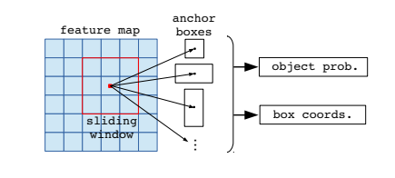
Region Proposal Network
All the convolution feature map that is generated by the previous layer is passed through a 3*3 convolution layer.
The output of this then passed into two parallel branches that determine the objectness score and regress the bounding box coordinates.
Here, only use only one anchor stride and 3 anchor ratios for a feature pyramid (because we already have feature maps of different sizes to check for objects of different size).

Slide 16
A mask contains spatial information about the object.
Thus, unlike the classification and bounding box regression layers, we could not collapse the output to fully connected layer to improve since it requires pixel-to-pixel correspondence from the above layer.
Mask R-CNN uses a fully connected network to predict the mask.
This ConvNet takes an RoI as input and outputs the m*m mask representation. We also upscale this mask for inference on input image and reduce the channels to 256 using 1*1 convolution.
In order to generate input for this fully connected network that predicts mask, we use RoIAlign.
The purpose of RoIAlign is to use convert different size feature map generated by region proposal network into a fixed-size feature map.
Mask R-CNN paper suggested two variants of architecture. In one variant, the input of mask generation CNN is passed after RoIAlign is applied (ResNet C4), but in another variant, the input is passed just before the fully connected layer (FPN Network).

Slide 17
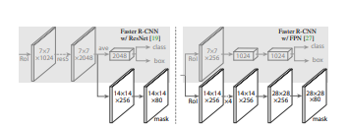
Mask Representation:
This mask generation branch is fully convolution network and it output a K * (m*m), where K is the number of classes (one for each class) and m=14 for ResNet-C4 and 28 for ResNet_FPN.

Slide 18
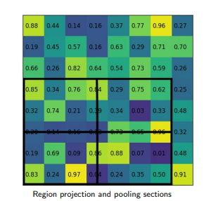
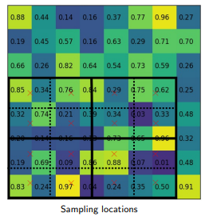
RoI Align:
RoI align has same motive as of RoI pool, to generate the fixed size regions of interest from region proposals. It works in following steps:
Given the feature map of previous Convolution layer of size h*w, divide this feature map into M * N grids of equal size (we will NOT just take integer value).

Slide 19
The mask R-CNN inference speed is around 2 fps, which is good considering the addition of segmentation branch in the architecture.
Applications : Due to its additional capability to generate segmented mask, it is used in many computer vision applications such as:
Human Pose Estimation
Self Driving Car
Drone Image Mapping etc.

Slide 20
Advantages of Mask R-CNN
Simplicity: Mask R-CNN is simple to train.
Performance: Mask R-CNN outperforms all existing, single-model entries on every task.
Efficiency: The method is very efficient and adds only a small overhead to Faster R-CNN.
Flexibility: Mask R-CNN is easy to generalize to other tasks. For example, it is possible to use Mask R-CNN for human pose estimation in the same framework.

Slide 21
Everything about Mask R-CNN: A Beginner's Guide - viso.ai

